Slide 1
ASSEMBLER-INTERFACE
CS322 MINI-PROJECT
SANSKRITI SINGH
2001CS60

Slide 2



LANGUAGES AND PACKAGES USED

Slide 3
Building the Interface
Using Glade to design the Interface (Frontend)
Using Python for the inner workings (Backend)

Slide 4
Working with Glade

Slide 5
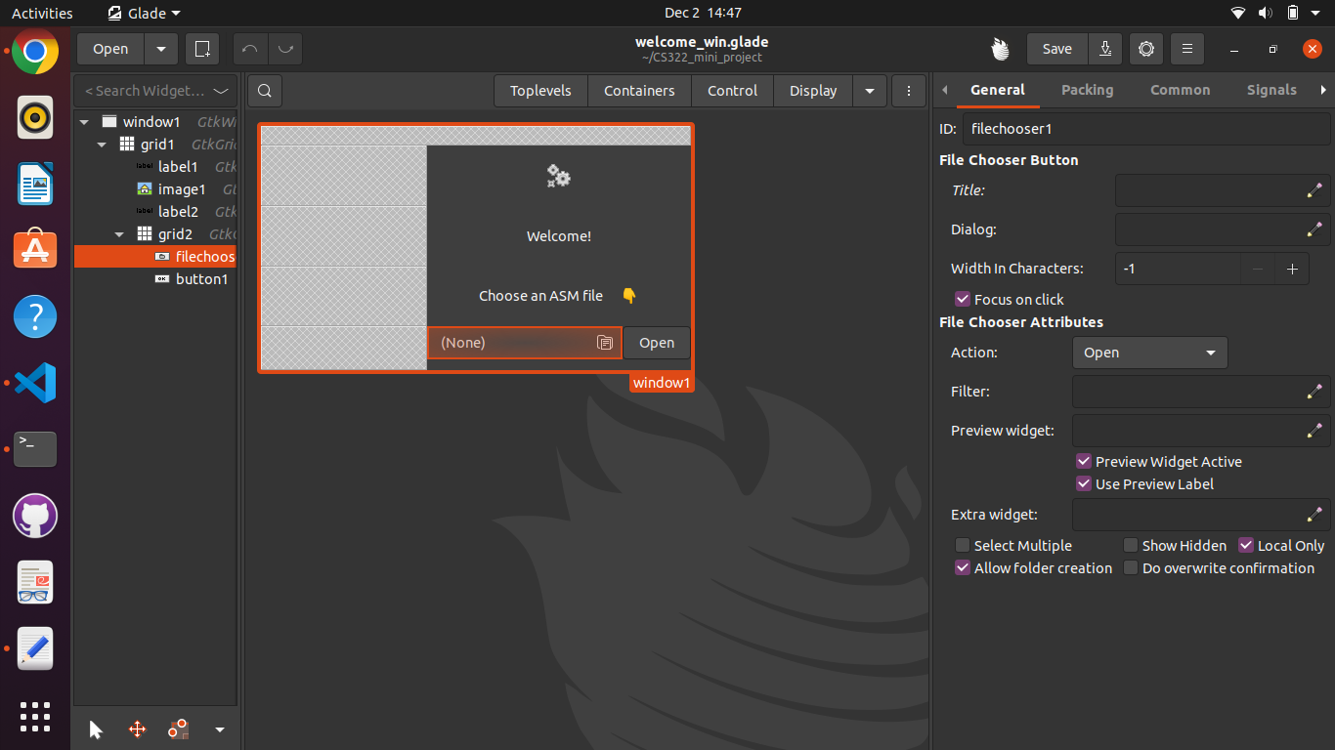
Designing a window
Choose widgets and set parameters
Give each widget a unique name

Slide 6
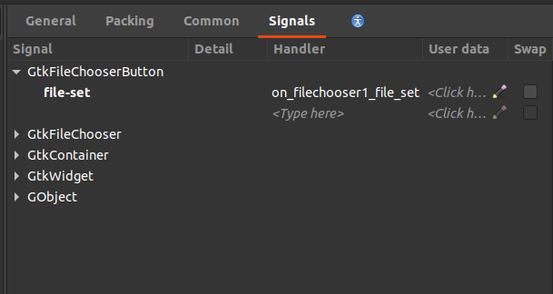
Designing a window
Widgets work on signals
Define functions that activate that signals to be used in backend

Slide 7
Windows that were made

Slide 8
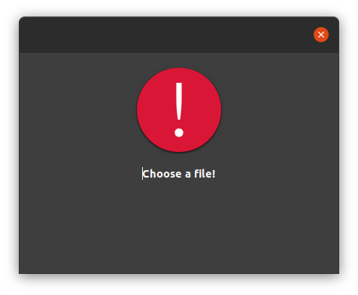
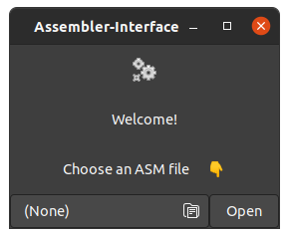
Welcome.glade (the filechooser page)
& warning_dialogue.glade

Slide 9
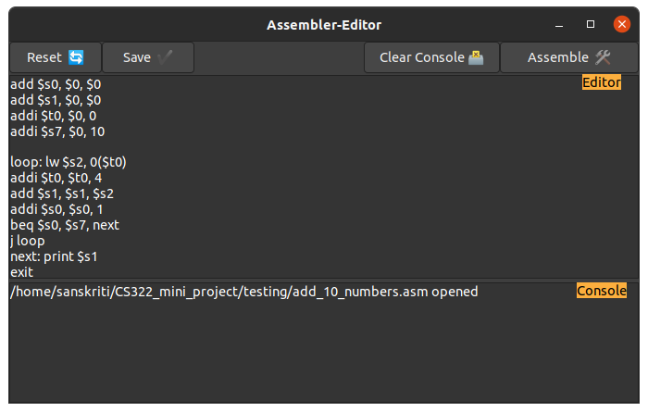
assemble_win.glade (the editor and console page)

Slide 10
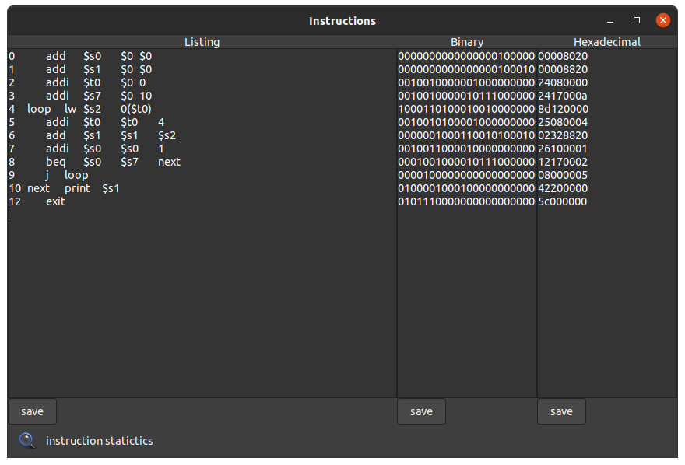
instructions_win.glade (the output display page)

Slide 11
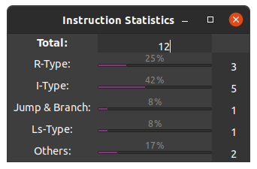
stat_win.glade (the output display page)

Slide 12
Working with Python

Slide 13
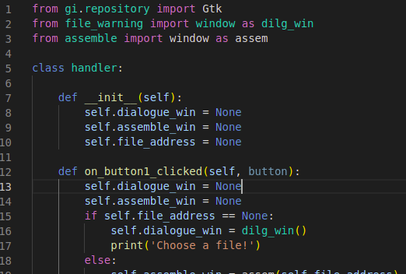
Writing Backend
Import Gtk package
Make a class named handler which will control the widgets signal

Slide 14
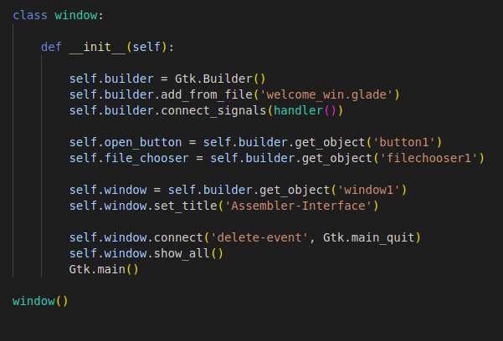
Writing Backend
Make a class named window
Here we will define objects including main window
Connect it to the handler class

Slide 15
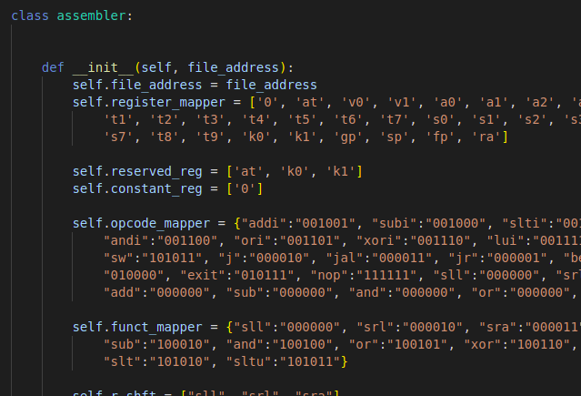
Writing Backend
Make other necessary python files (assembler) to give the final output

Slide 16
Python files that were made

Slide 17
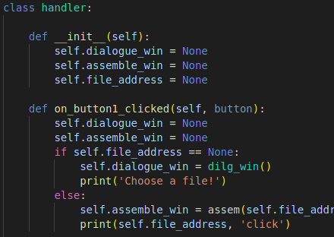
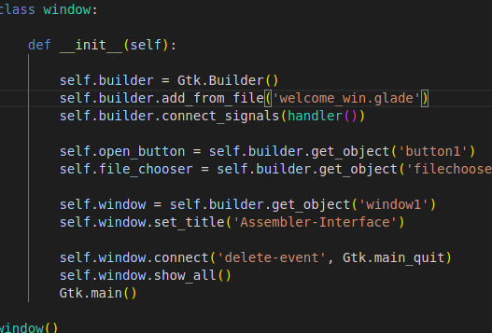
Welcome.py (for welcome window)

Slide 18
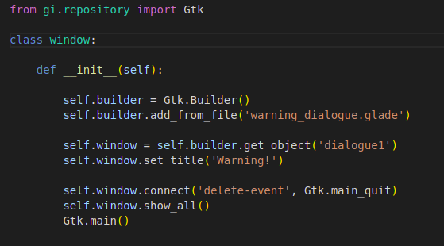
file_warning.py (for warning dialogue box)

Slide 19
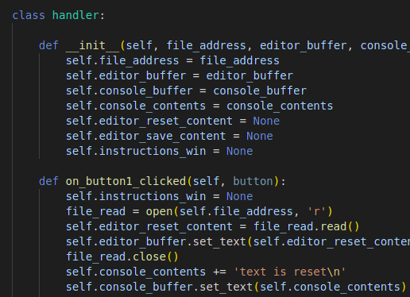
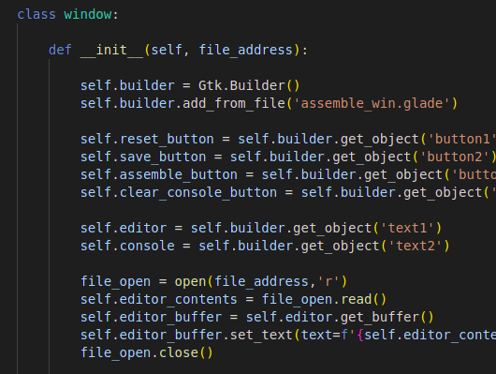
assemble.py (for editor - console window)

Slide 20
assembler.py (MIPS to instructions)

Slide 21
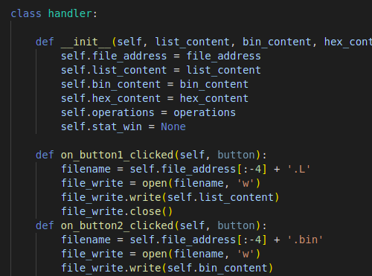
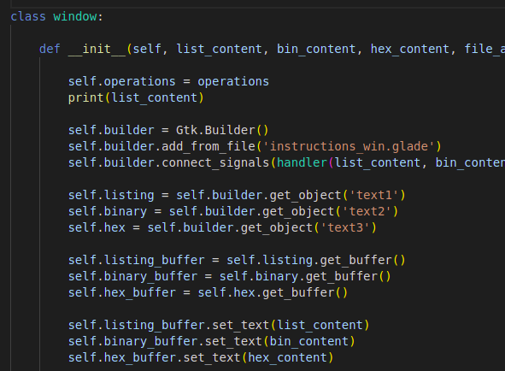
instructions.py (for instructions output window)

Slide 22
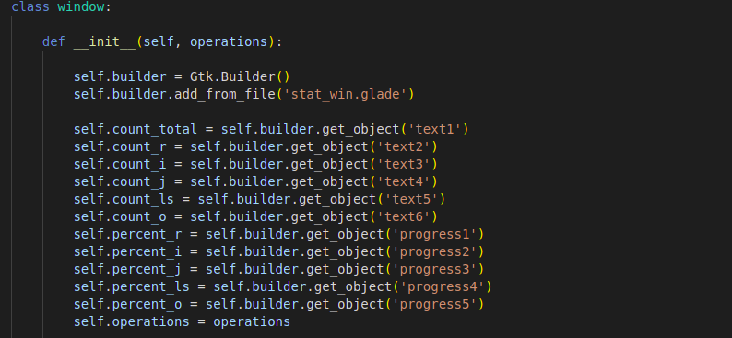
instructions_stats.py (for instructions output window)

